Slide 1
Presentation title
Speaker Name(s)

Slide 2
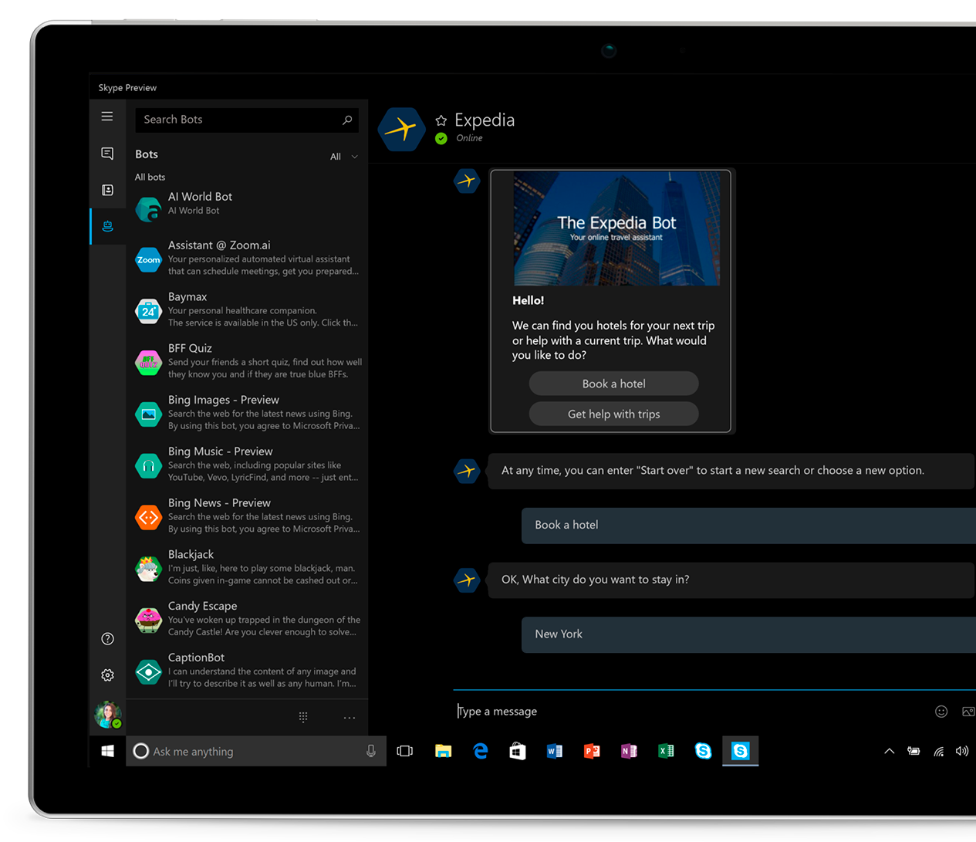
Command Line
C:\
Tell me what to do
using a language you don’t know
Powerful
Huge learning curve
Unintuitive
Not visually rich

Slide 3
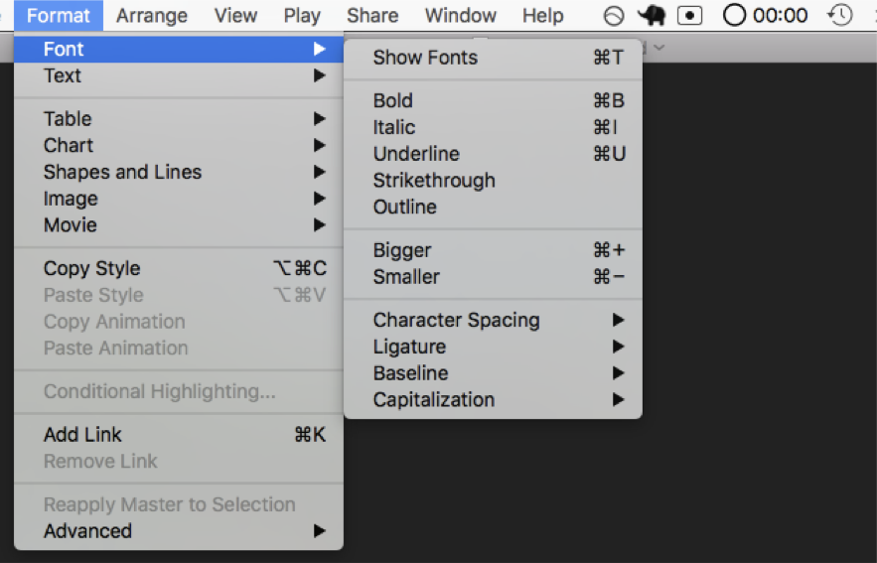
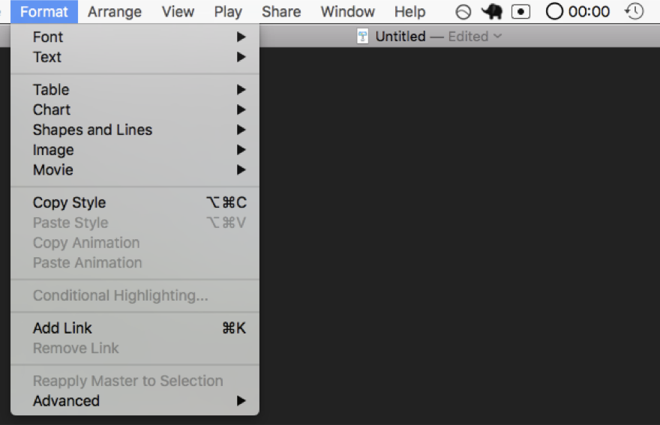
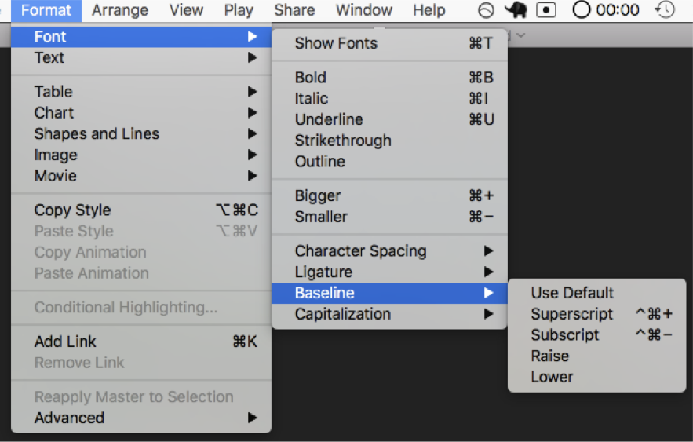
Graphical User Interfaces
Shows the user capabilities with windows, icons, menus and pointers
More intuitive
Still have a learning curve
Menus have submenus

Slide 4
IT’S YOUR JOB TO FIGURE OUT THE COMPUTER
LET’S MAKE
THE COMPUTER FIGURE OUT YOU
THE COMPUTER

Slide 5
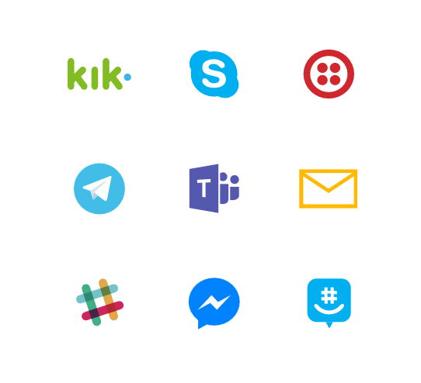
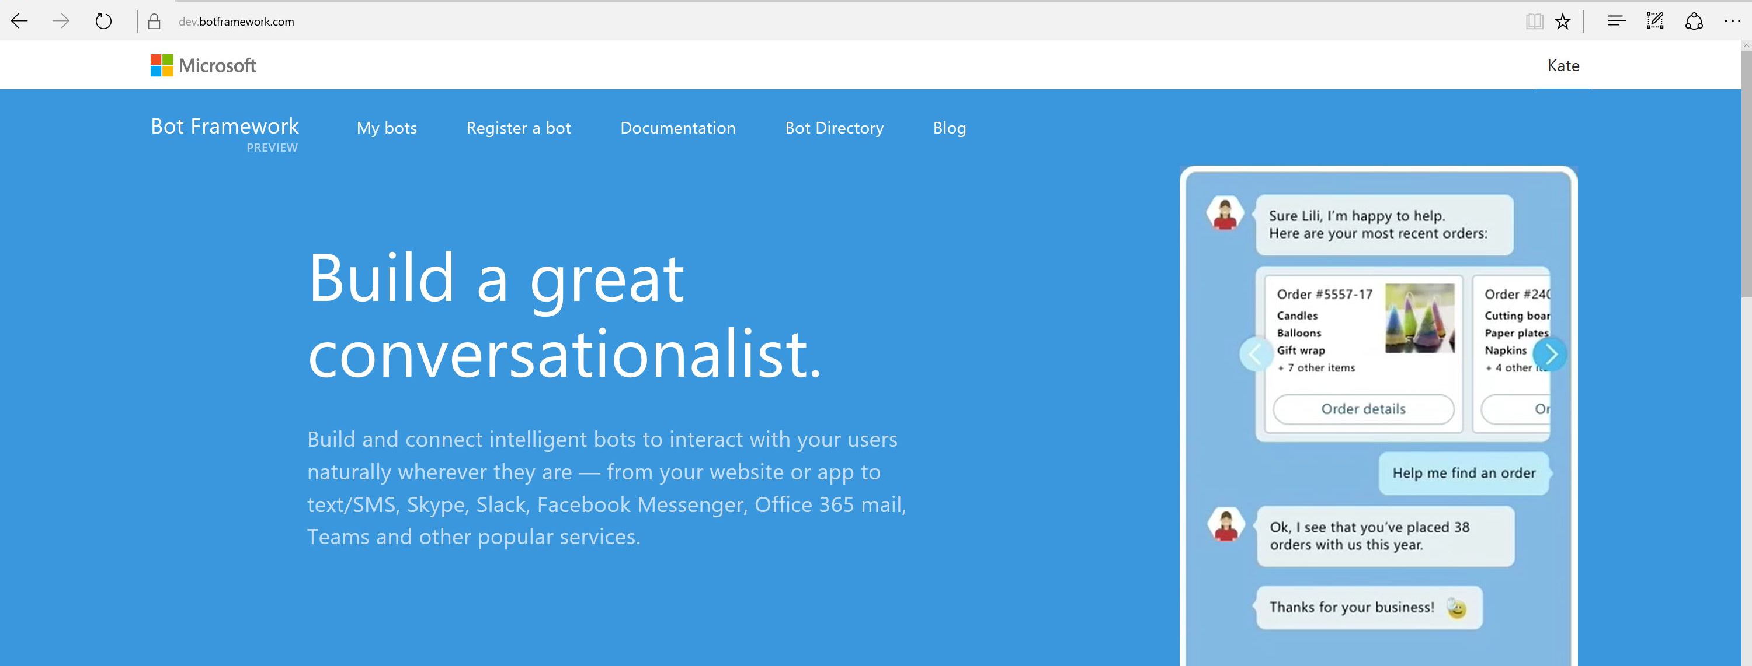
Bot Framework

Slide 6
What is a bot?
Notes:
Given all that, what is a bot?

Slide 7
A bot is an app

Slide 8
Similar design, different paradigm
Traditional Application
Bot
Main Screen
Root Dialog
New Order Screen
Product Search Screen
New Order Dialog
Product Search Dialog

Slide 9
An x-ray of a typical bot
Conversation Canvas/Channels
Your bot code goes here
Web Chat
Bot Connector Service
Email
Message input <> output
State Management
Facebook
Bot web service
GroupMe
Your bot code
Bot Builder SDK
Kik
Skype
Bot Builder SDK
API, SDK calls
Slack
+ Microsoft Cognitive Services
Telegram
Other services, APIs,
Databases, Azure Machine Learning, Azure Search, etc…
Natural Language
Translation
Vision/Face
Emotion
Twilio (SMS)
…
Direct Line…
Speech
Entity Extraction
Search
Knowledge API
…
…
…

Slide 10
A bot is an app with a little more humanity
Notes:
In short, a bot is just a type of app. One that connects to users at a slightly more personal level.

Slide 11
But... Do you really need a bot?

Slide 12
Bots don’t inherently solve all problems
Address your core issues first
Determine if a different type of app might be appropriate
How will this be different from your existing website

Slide 13
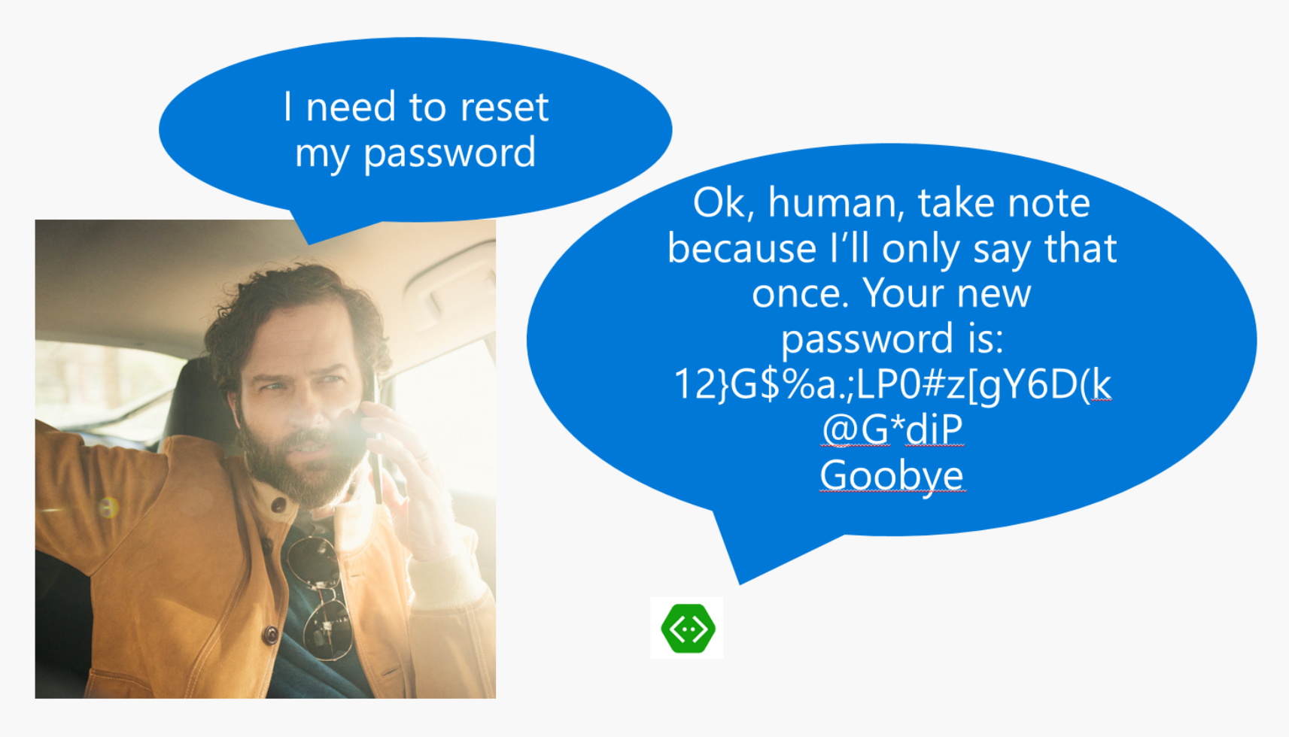
Anti-pattern: Canvas/input mismatch

Slide 14
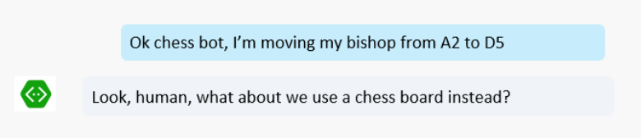
Anti-pattern: Canvas/input mismatch

Slide 15
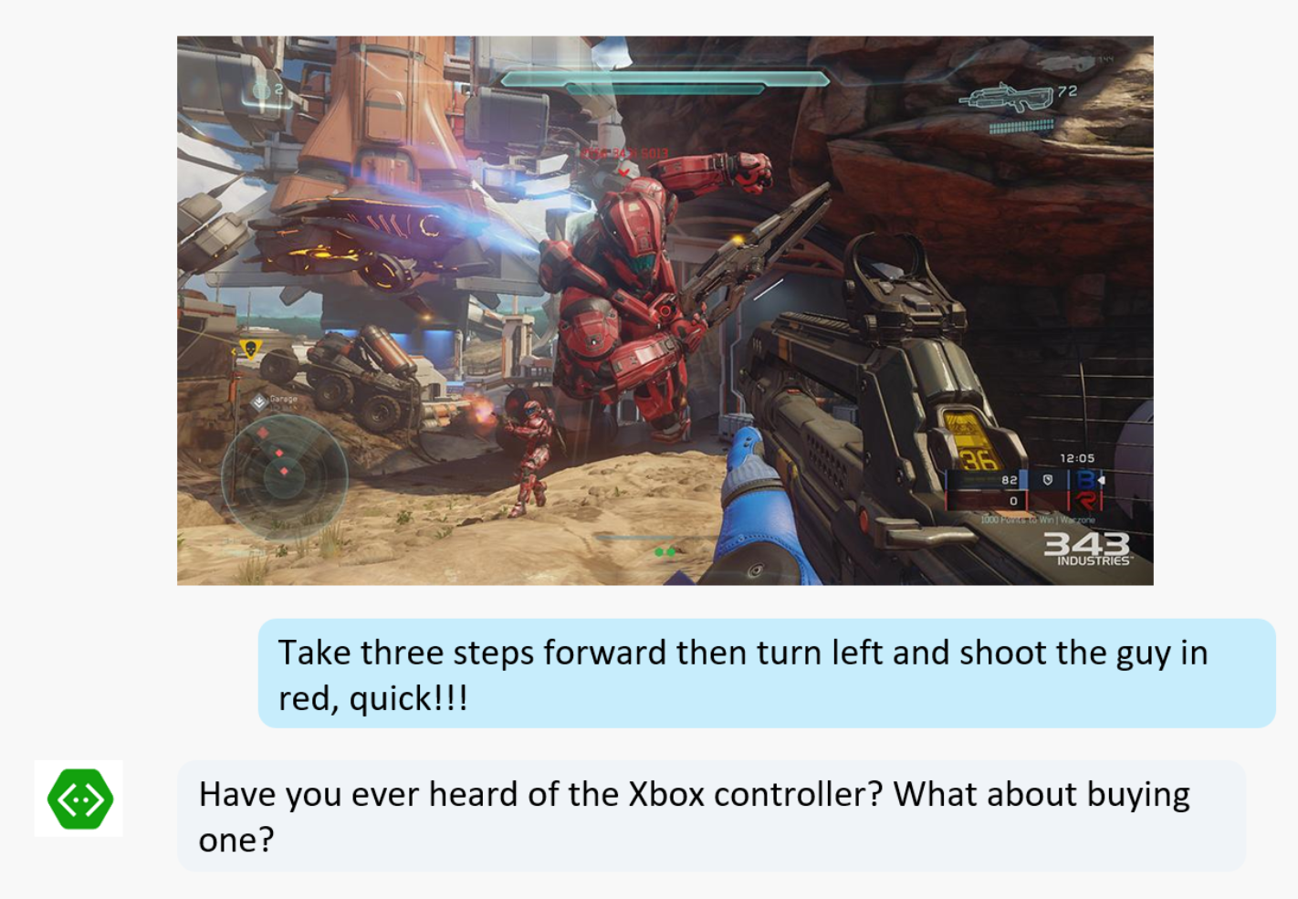
Anti-pattern: Canvas/input mismatch

Slide 16
Where do bots work best?

Slide 17
Pattern: Knowledge Base Bots
Bots that can reason over a corpus of data to find and return a piece of information
Event bots, Help Desk bots, Contact bots, etc.
#MSBuild

Slide 18
Pattern: Backchannel
Backchannel is the practice of using maintaining a real-time online conversation alongside the primary group activity or live spoken remarks

Slide 19
Pattern: Handoff to Human
Every company deals with this:
First triage/data collection
Simple and repetitive solutions
Customer call
Complex cases and escalation

